Slide 1

Presentation on Minor Project WIFI-Bot Car
Presented By Shivam Simran & Tulsi

Slide 2
CONTENTS
R&D (Research and Development)
Introduction to Project
Hardware Used
Software Used
Coding Phase
Mint App Inventor
Testing Phase
Working of Project
Future scope & Enhancement
Queries Related to Project

Slide 3
R&D (Research and Development)
Research for various projects related to the hardware.
Gathering information, knowledge and details.
Also learning new things about hardware and how to implement them.
Selection of a project on the base of time, budget and skills.
Where to order them economically.
How to code them in Flash memory of a hardware with the help of a Software.

Slide 4
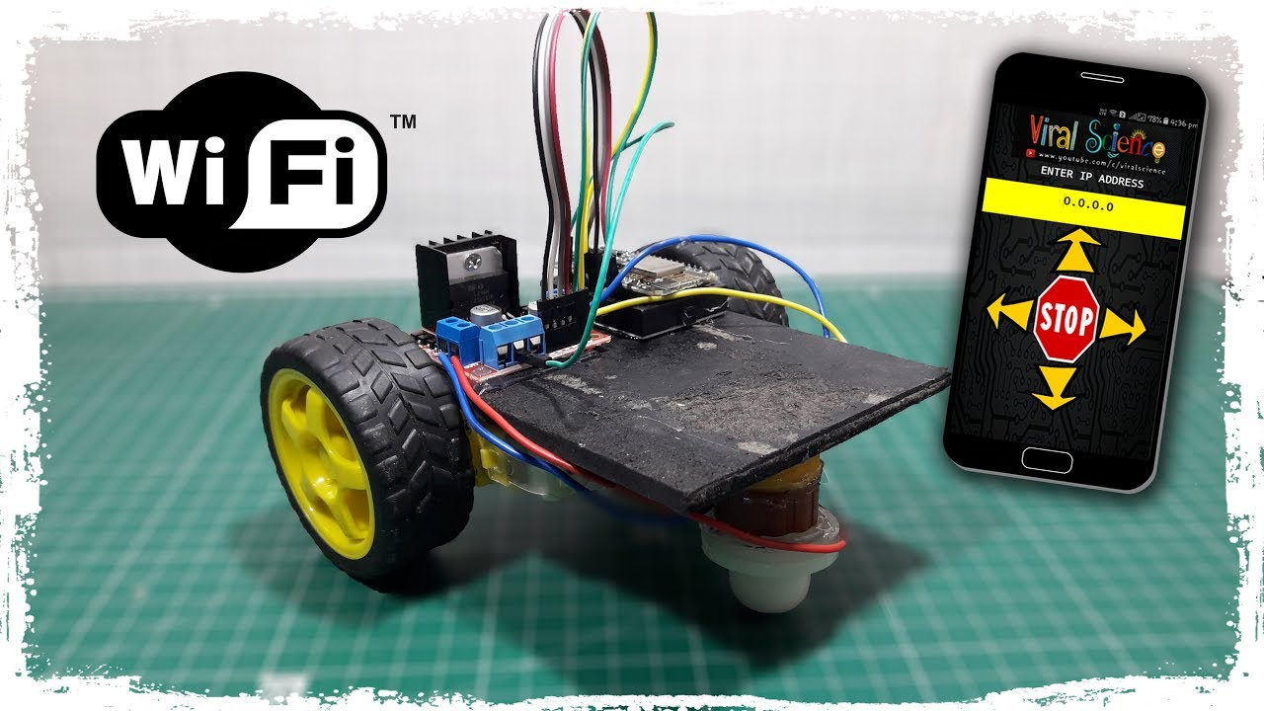
Introduction to Project
Project name → WIFI-BOT CAR
A WIFI-Bot Car Based on (Hardware) NodeMCU that operates with the helps of an mobile application. It moves forward, backward, left and right.

Slide 5
Hardware Used
NodeMCU ESP8266-12E
DC Motor
Chassis
Micro USB Cable (For NodeMCU)
Jumper Wires (M to M, F to M, F to F)
Mini Bread Board
Motor Driver L293D
9 Volt Battery
Caster wheel

Slide 6
Software Used
Arduino IDE
Android Application
Android Device

Slide 7
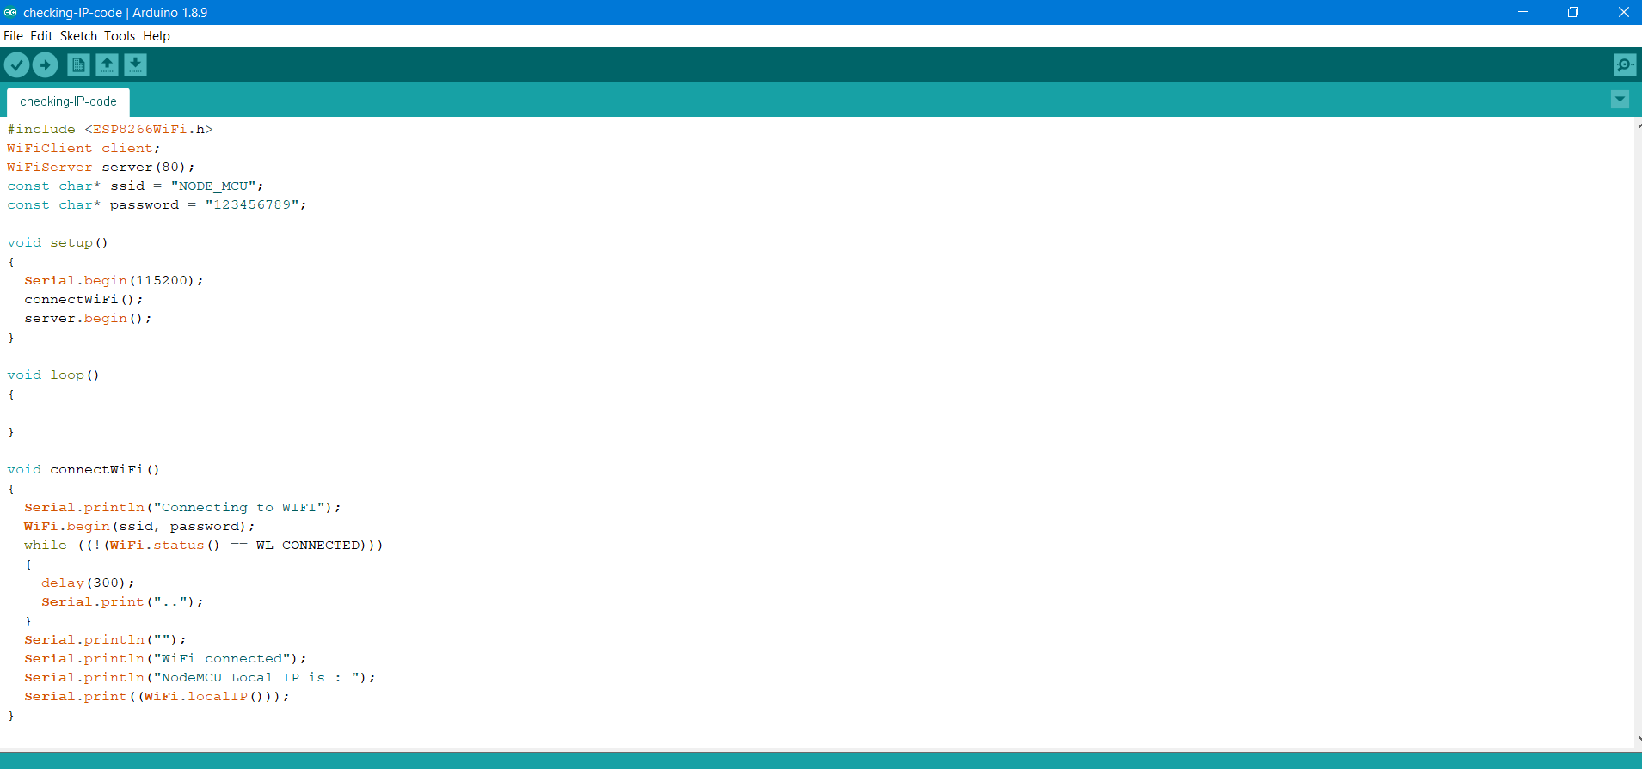
Coding Phase

Slide 8
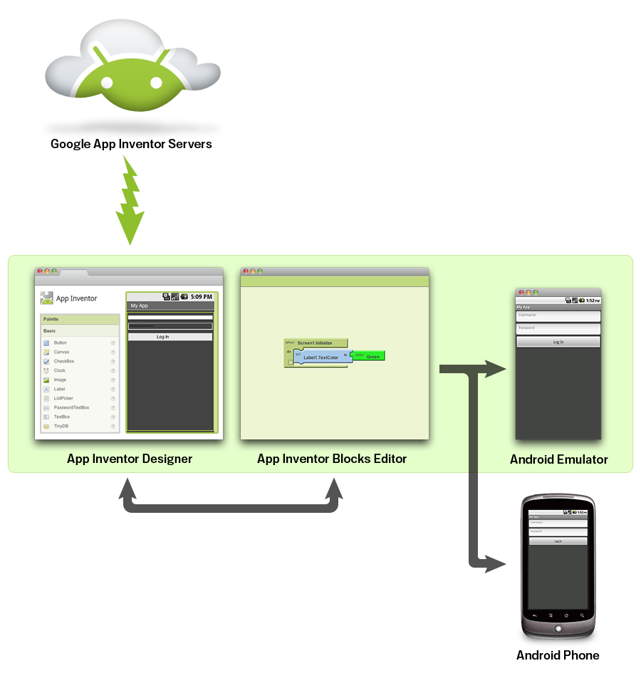
Mint App Inventor
App Inventor lets you develop applications for Android phones using a web browser and either a connected phone or emulator. The App Inventor servers store your work and help you keep track of your projects.

Slide 9
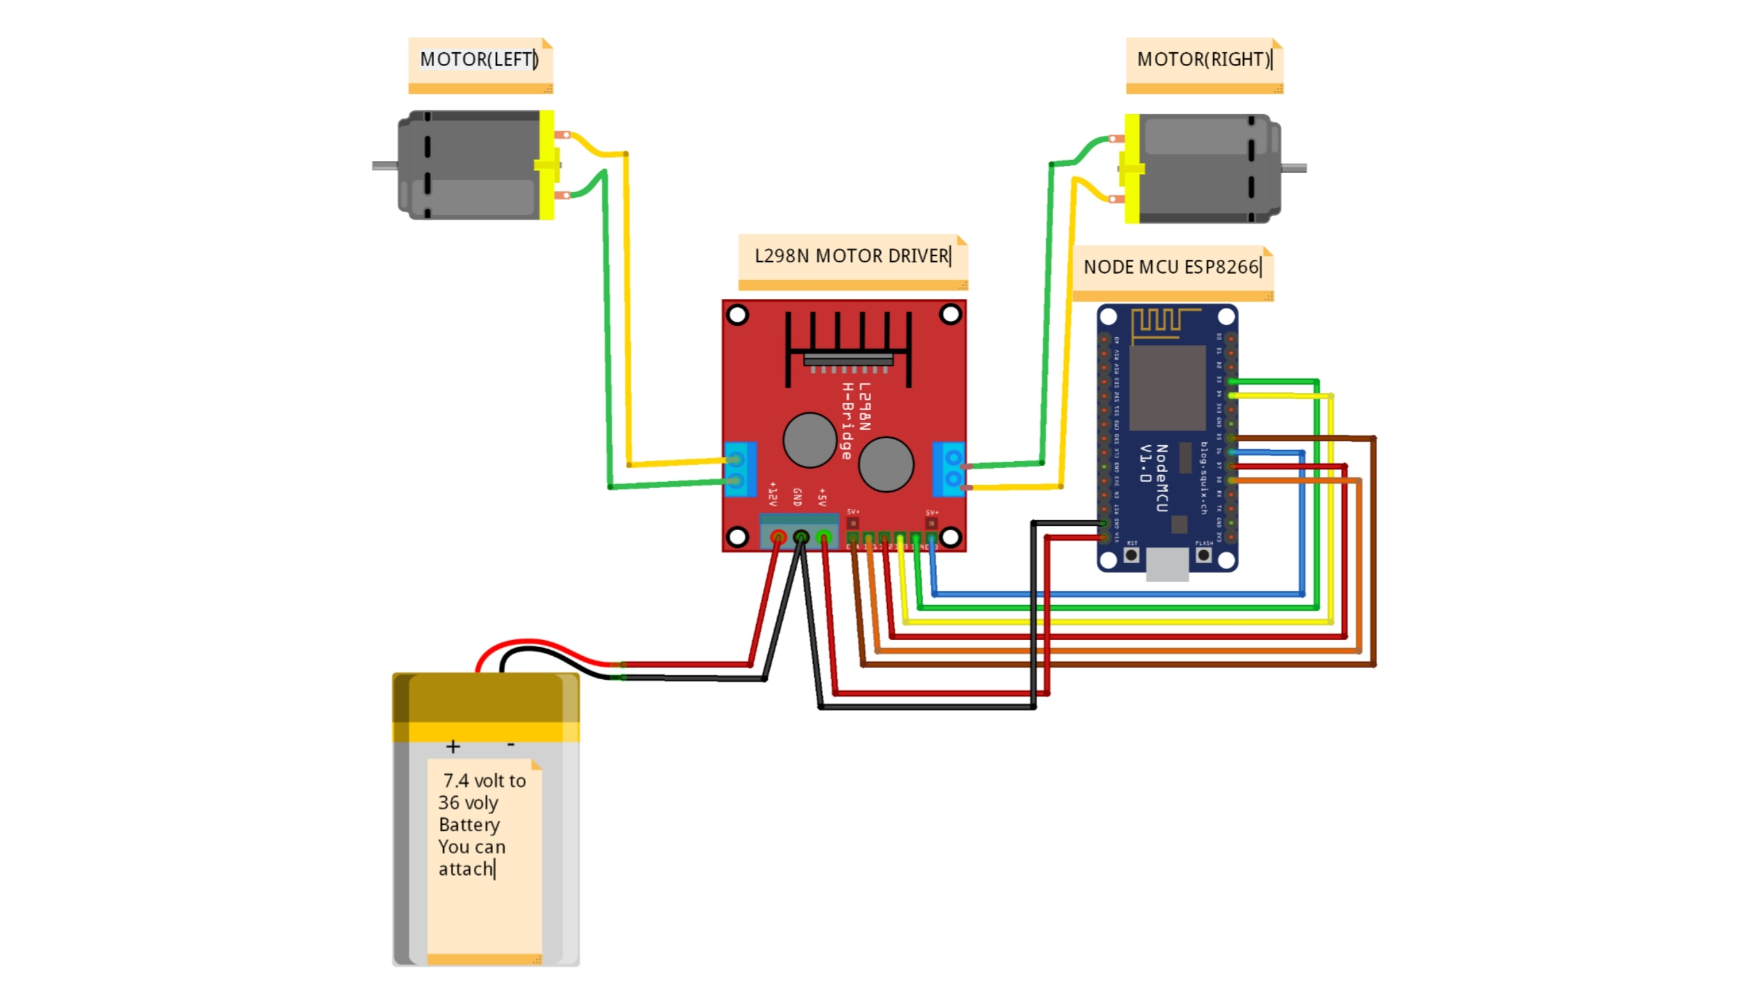
Working of Project

Slide 10
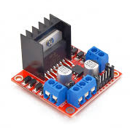
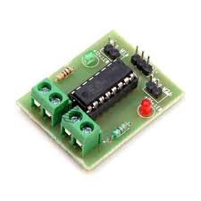
Testing Phase
L293d
L298n

Slide 11
Future Scope & Enhancement
WIFI will be a key access technology for Internet of Things enablement due to cost coverage and bandwidth, challenges with mobile cellular which can be compromised through WIFI. The era of sensor in here. sensor is used in all over the devices to make the thing easier and more flexible main advantage to use the sensor is to reduce the human. In over WIFI bot car if we mounted an sensor over it then we can deduct the thing that can in the range of the that sensor and also command to avoid collision from the objects in the way of over WIFI bot. and all these thing can done by the WIFI bot. we can also see the things that can comes in the way of the WIFI bot in over screen through the help of the processing ide and Arduino ide .

Slide 12
Queries Related to Project
?

Slide 13


